Slide 1
IC Checker
Kelompok 15

Slide 2
Introduction

Slide 3

Members
Edgrant Henderson Suryajaya
Fairuz Muhammad
Dimas Dandossi Wicaksono
Fadlihajjan Carel Agfata

Slide 4
Project Overview

Slide 5
Goals
Alat dapat memilih jenis IC melalui tombol
Alat dapat memeriksa setiap pin dari IC yang dipilih secara otomatis
Alat dapat menampilkan jenis IC yang diperiksa pada LCD
Sistem harus mudah digunakan dan memberikan hasil yang akurat

Slide 6
Hardware

Slide 7
Hardware Overview
Arduino Uno
Breadboard
LED - 1 buah
LCD 16x2 with I2C
Kabel jumper male to male
Kabel jumper male to female
Baterai 9V
7805 voltage regurator

Slide 8
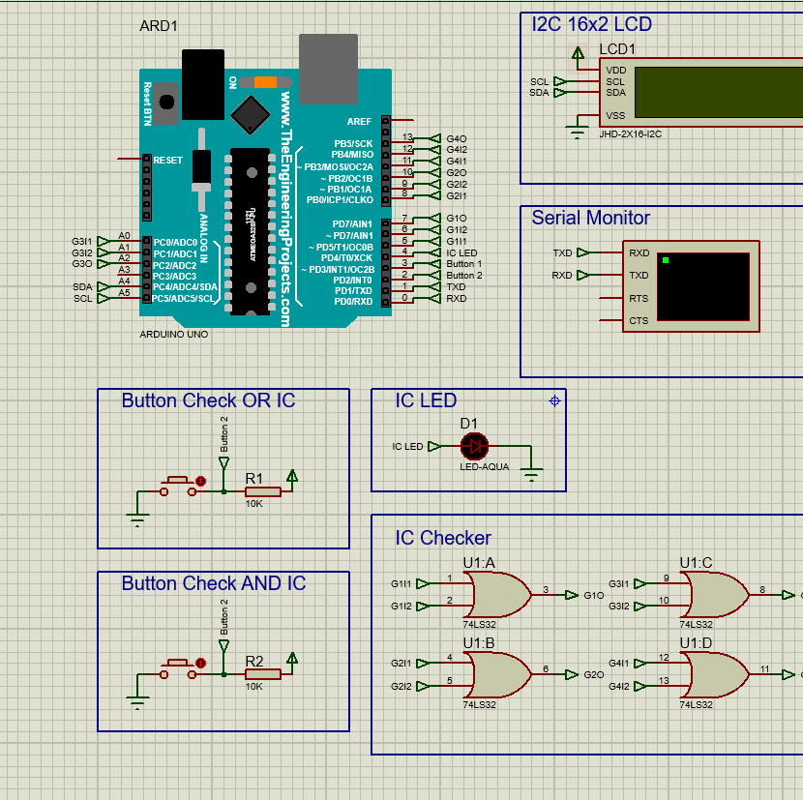
Hardware Layout

Slide 9
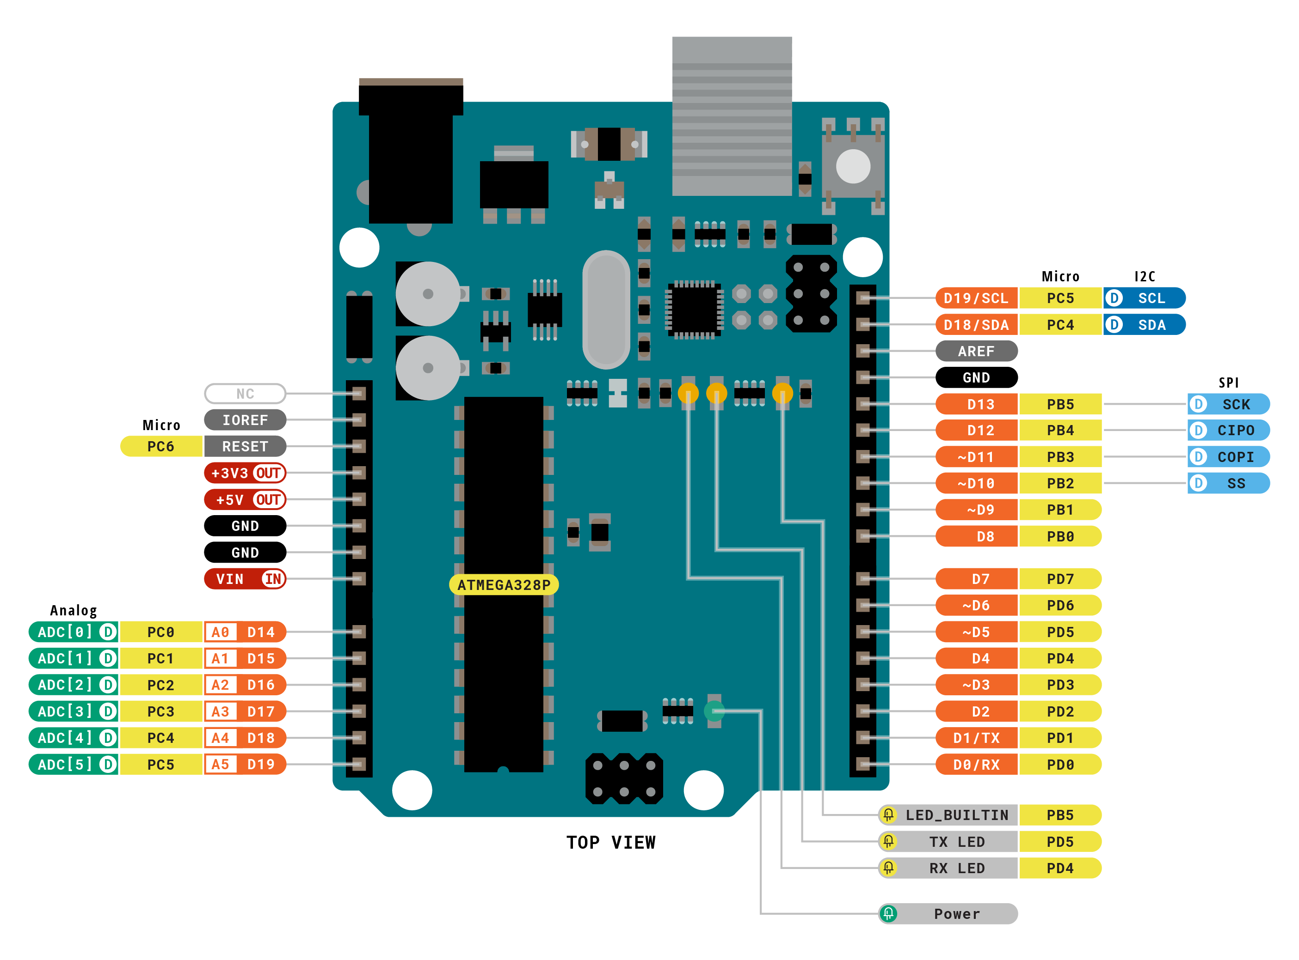
Logika Rangkaian
Proses pengecekan IC
Output LED
Output LCD
Arduino Uno

Slide 10
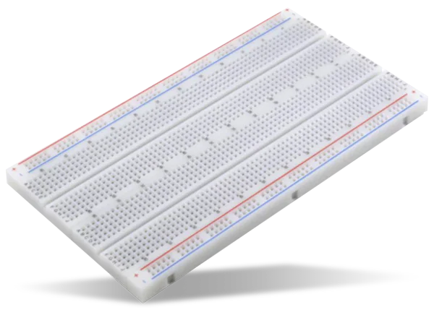
Breadboard
Kerangka Rangkaian
- Menghubungkan Kabel Jumper

Slide 11

Button
Input
Memicu Interupt pada Arduino
Button Hijau: Mulai pengecekan IC AND
Button Biru: Mulai pengecekan IC OR

Slide 12
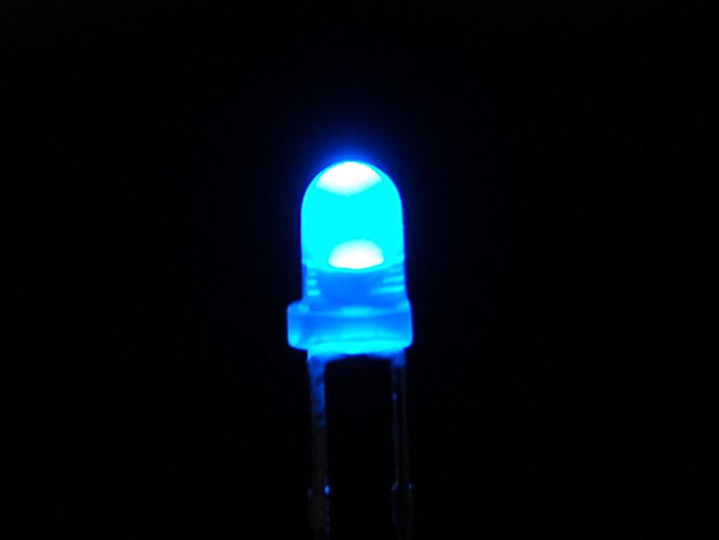
LED
Output
- Indikator IC berfungsi

Slide 13
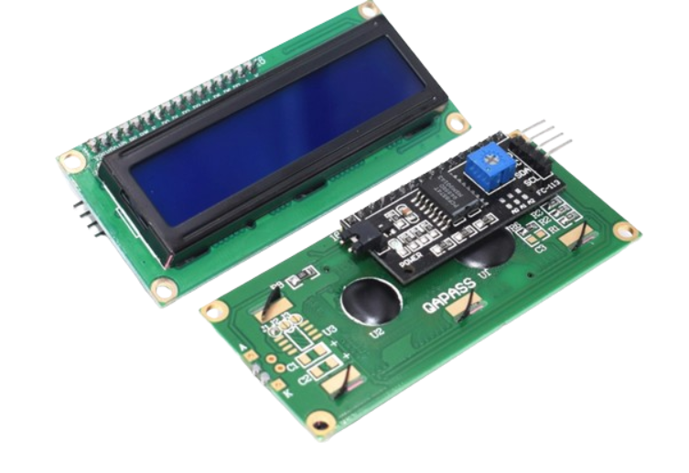
I2C LED
Output
Menunjukkan IC yang dicek
Menunjukkan apakah IC berfungsi dengan baik

Slide 14
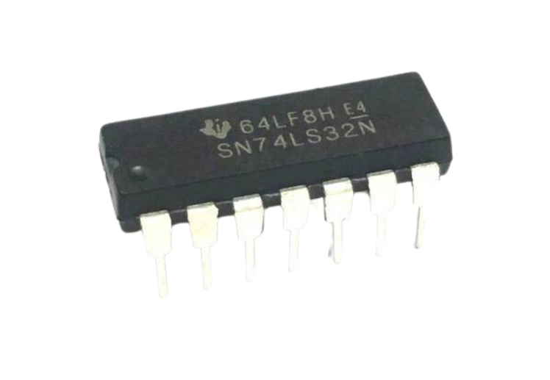
IC
Subjek yang dicek
- Program support pengecekan IC AND (7408) dan IC OR (7432)

Slide 15
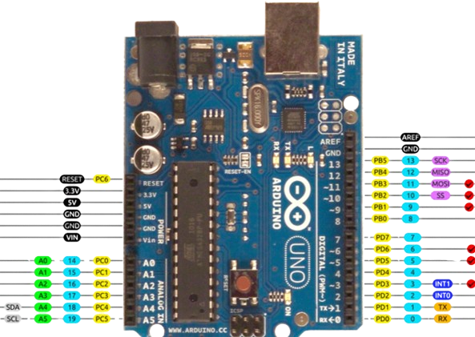
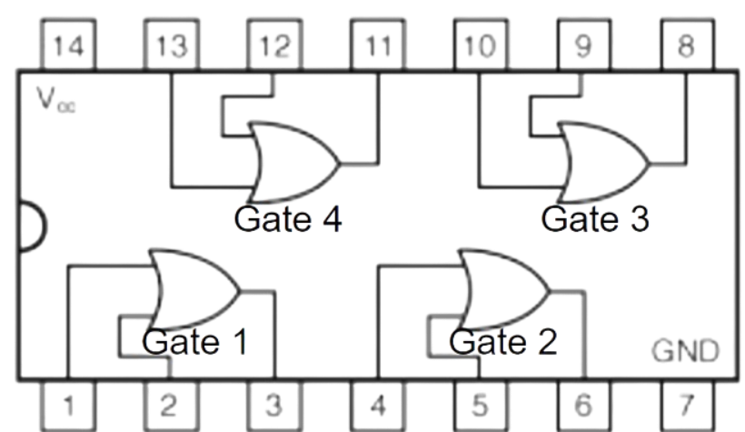
Pins
; Pin
; D3 Button Interupt 1 (AND)
; D2 Button Interupt 2 (OR)
; A4, A5 I2C LCD
; A0-2 (Check Gate 3)
; B3-5 (Check Gate 4)
; B0-2 (Check Gate 2)
; D5-7 (Check Gate 1)
; D4 (LED IC tidak rusak)

Slide 16
Software

Slide 17
Registers
; Global Register
; R16: Parameter Passing
; R17-20: Local Scope
; R25-R26: Ascii stuff serial monitor
; R21: Menyimpan Data testing Gate 1
; R22: Menyimpan Data testing Gate 2
; R23: Menyimpan Data testing Gate 3
; R24: Menyimpan Data testing Gate 4
; R27: I2C

Slide 18
Variables
;-------------------------
; Variable ; Port D
.equ G1I1, 5 ; Gate 1 Input 1
.equ G1I2, 6 ; Gate 1 Input 2
.equ G1O, 7 ; Gate 1 Output
; Port B
.equ G2I1, 0 ; Gate 2 Input 1
.equ G2I2, 1 ; Gate 2 Input 2
.equ G2O, 2 ; Gate 2 Output
.equ G4I1, 3 ; Gate 4 Input 1
.equ G4I2, 4 ; Gate 4 Input 2
.equ G4O, 5 ; Gate 4 Output
; Port C
.equ G3I1, 0 ; Gate 3 Input 1
.equ G3I2, 1 ; Gate 3 Input 2
.equ G3O, 2 ; Gate 3 Output
;-------------------------

Slide 19
Function Overview
Deklarasi variabel: modul ini berisi deklarasi variabel pin input dan output
Setup: modul ini berisi inisialisasi pin input dan output, serta inisialisasi serial communication, I2C, dan Interrupt
Delay: modul ini berisi fungsi delay yang digunakan dalam program
Serial: modul ini berisi fungsi-fungsi yang digunakan dalam komunikasi serial
LCD: modul ini berisi fungsi-fungsi yang digunakan menampilkan data pada LCD
Checker: modul ini berisi fungsi-fungsi yang digunakan dalam pengecekan IC

Slide 20
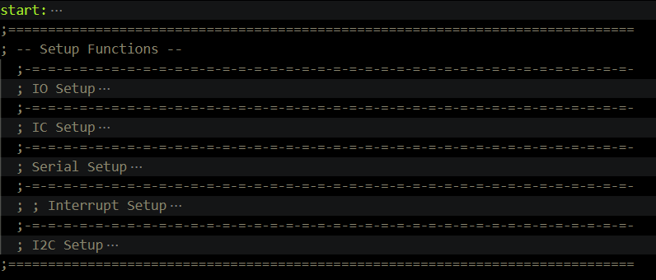
Setup Overview

Slide 21
Setup IO
; IO Setup
io_setup:
SBI DDRD, 4 ; pin D4 dipakai untuk output apakah IC rusak atau tidak
CBI DDRD, 2 ; pin D2 dipakai untuk input button interupt 2 (button confirm) [biru]
SBI PORTD, 2 ; pull-up resistor
CBI DDRD, 3 ; pin D3 dipakai untuk input button interupt 1 (button cycle) [hijau]
SBI PORTD, 3 ; pull-up resistor
RET ; !!!!!!!!!!!!!RETURN!!!!!!!!!!!!!!

Slide 22
Setup IC
; IC Setup
; IC 2 input 1 output combo
ic_setup:
; Gate 3 (A2, A3, A4)
SBI DDRC, G3I1 ; Set Gate 3 Input 1 as output
SBI DDRC, G3I2 ; Set Gate 3 Input 2 as output
CBI DDRC, G3O
; Gate 4 (B3, B4, B5)
SBI DDRB, G4I1
SBI DDRB, G4I2
CBI DDRB, G4O
; Gate 2 (B0, B1, B2)
SBI DDRB, G2I1
SBI DDRB, G2I2
CBI DDRB, G2O
; Gate 1 (D5, D6, D7)
SBI DDRD, G1I1
SBI DDRD, G1I2
CBI DDRD, G1O
RET ; !!!!!!!!!!!!!RETURN!!!!!!!!!!!!!!

Slide 23
Setup Serial
; Serial Setup
serial_setup:
CLR R17
STS UCSR0A, R17 ; clear UCSR0A register
STS UBRR0H, R17 ; clear UBRR0H register
LDI R17, 51 ; & store in UBRR0L 51
STS UBRR0L, R17 ; to set baud rate 19200
LDI R17, 1<<RXEN0 | 1<<TXEN0
STS UCSR0B, R17 ; enable RXB & TXB
LDI R17, 1<<UCSZ00 | 1<<UCSZ01
STS UCSR0C, R17 ; asynch, no parity, 1 stop, 8 bits
;-----------------------------------------------------------------------
LDI R25, 48 ; constants used to get ASCII values
LDI R26, 7 ; for chars 0-->9 & A-->F
RET ; !!!!!!!!!!!!!RETURN!!!!!!!!!!!!!!

Slide 24
Setup Interupt (in C)
void setupButton() {
// setup int 0, check_or button
EICRA |= (1 << ISC01); // Set interrupt on falling edge
EICRA &= ~(1 << ISC00);
// Enable interrupt
EIMSK |= (1 << INT0);
// Enable global interrupt
sei();
// setup int 0, check_or button
EICRA |= (1 << ISC11); // Set interrupt on falling edge
EICRA &= ~(1 << ISC10);
// Enable interrupt
EIMSK |= (1 << INT1);
}

Slide 25
Setup Interupt (in C)
void setupButton() {
// setup int 0, check_or button
EICRA |= (1 << ISC01); // Set interrupt on falling edge
EICRA &= ~(1 << ISC00);
// Enable interrupt
EIMSK |= (1 << INT0);
// Enable global interrupt
sei();
// setup int 0, check_or button
EICRA |= (1 << ISC11); // Set interrupt on falling edge
EICRA &= ~(1 << ISC10);
// Enable interrupt
EIMSK |= (1 << INT1);
}

Slide 26
Setup I2C
; I2C Setup
CBI DDRC, 4 ; pin PC4 (SDA) is input
CBI DDRC, 5 ; pin PC5 (SCL) is input
CALL I2C_init ; initialize TWI module
CALL LCD_init ; initialize LCD

Slide 27
Delay Function 20ms
; Function Delay 20ms
delay_20ms:
LDI R17, 255
delay_l3: LDI R18, 210
delay_l4: LDI R19, 2
delay_l5: DEC R19
BRNE delay_l5
DEC R18
BRNE delay_l4
DEC R17
BRNE delay_l3
RET ; !!!!!!!!!!!!!RETURN!!!!!!!!!!!!!!

Slide 28
Delay Function 2s
; Function Delay 2s
delay_2s:
LDI R17, 255
delay_l6: LDI R18, 255
delay_l7: LDI R19, 164
delay_l8: DEC R19
BRNE delay_l8
DEC R18
BRNE delay_l7
DEC R17
BRNE delay_l6
RET ; !!!!!!!!!!!!!RETURN!!!!!!!!!!!!!!

Slide 29
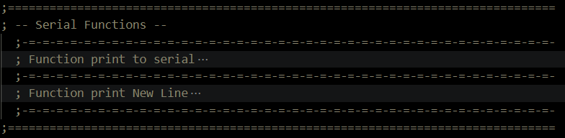
Serial Print Overview

Slide 30
Serial Print Hex
; Function print to serial
print_R16_Hex:
;-----------------------------------------------------------------
PUSH R16 ; store copy of R16 in STACK register
ANDI R16, 0xF0 ; mask & extract high-nibble
SWAP R16 ; swap high-nibble with low-nibble
ADD R16, R25 ; add 48 to byte to get ASCII char 0 to 9
MOV R17, R16 ; store a copy of byte in R17
SUBI R17, 58 ; subtract 58 from R17
BRPL A_F_MSD ; jump if result is positive
;-----------------------------------------------------------------
print_l2:
LDS R17, UCSR0A
SBRS R17, UDRE0 ; test data buffer if data can be sent
RJMP print_l2
;-----------------------------------------------------------------
STS UDR0, R16 ; print Var mid digit on serial monitor
;-----------------------------------------------------------------
POP R16 ; restore R16 value from STACK register
ANDI R16, 0x0F ; mask & extract low-nibble
ADD R16, R25
MOV R17, R16
SUBI R17, 58
BRPL A_F_LSD
;-----------------------------------------------------------------
print_l3:
LDS R17, UCSR0A
SBRS R17, UDRE0 ; test data buffer if data can be sent
RJMP print_l3
;-----------------------------------------------------------------
STS UDR0, R16 ; print Var LSD on serial monitor
;-----------------------------------------------------------------
print_l4:
LDS R17, UCSR0A
SBRS R17, UDRE0 ; test data buffer if data can be sent
RJMP print_l4
;-----------------------------------------------------------------
;-----------------------------------------------------------------
print_l5:
LDS R17, UCSR0A
SBRS R17, UDRE0 ; test data buffer if data can be sent
RJMP print_l5
;-----------------------------------------------------------------
RET ; !!!!!!!!!!!!!RETURN!!!!!!!!!!!!!!
A_F_MSD:
ADD R16, R26 ; add 7 to byte to get ASCII chars A to F
RJMP print_l2
;---------------------------------------------------------------------
A_F_LSD:
ADD R16, R26 ; add 7 to byte to get ASCII chars A to F
RJMP print_l3

Slide 31
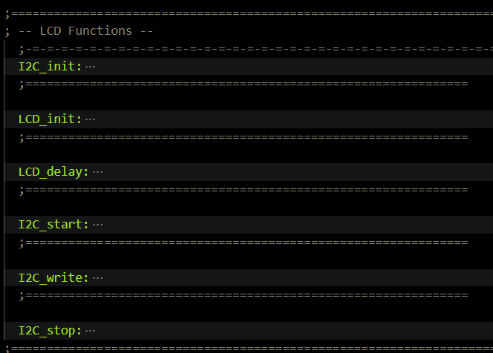
I2C LCD Overview

Slide 32
I2C LCD Init
I2C_init:
LDI R21, 0
STS TWSR, R21 ; prescaler = 0
LDI R21, 12 ; division factor = 12
STS TWBR, R21 ; SCK freq = 400kHz
LDI R21, (1<<TWEN)
STS TWCR, R21 ; enable TWI
RET
LCD_init:
CALL I2C_start
LDI R27, (0x27<<1)
CALL I2C_write
LDI R27, 0x00 ; Control byte: Co = 0, RS = 0
CALL I2C_write
LDI R27, 0x38 ; Function set: 8-bit, 2 line, 5x7 dots
CALL I2C_write
CALL LCD_delay
LDI R27, 0x0C ; Display on, cursor off, blink off
CALL I2C_write
CALL LCD_delay
LDI R27, 0x01 ; Clear display
CALL I2C_write
CALL LCD_delay
LDI R27, 0x06 ; Entry mode set: increment automatically, no shift
CALL I2C_write
CALL LCD_delay
CALL I2C_stop
RET

Slide 33
I2C LCD Print
I2C_start:
LDI R21, (1<<TWINT)|(1<<TWSTA)|(1<<TWEN)
STS TWCR, R21 ; transmit START condition
wt1:
LDS R21, TWCR
SBRS R21, TWINT ; TWI interrupt = 1?
RJMP wt1 ; wait for end of transmission
RET
;==============================================================
I2C_write:
STS TWDR, R27 ; copy SLA+W into data register
LDI R21, (1<<TWINT)|(1<<TWEN)
STS TWCR, R21 ; transmit SLA+W
wt2:
LDS R21, TWCR
SBRS R21, TWINT
RJMP wt2 ; wait for end of transmission
RET
;==============================================================
I2C_stop:
LDI R21, (1<<TWINT)|(1<<TWSTO)|(1<<TWEN)
STS TWCR, R21 ; transmit STOP condition
RET

Slide 34
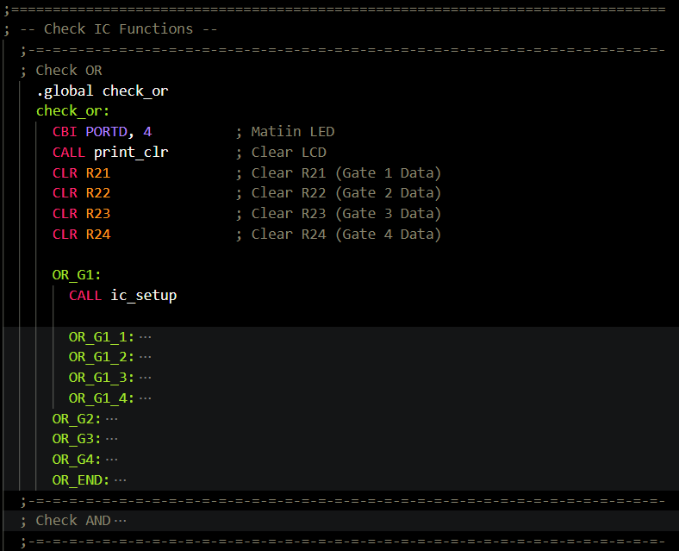
IC Check Overview

Slide 35
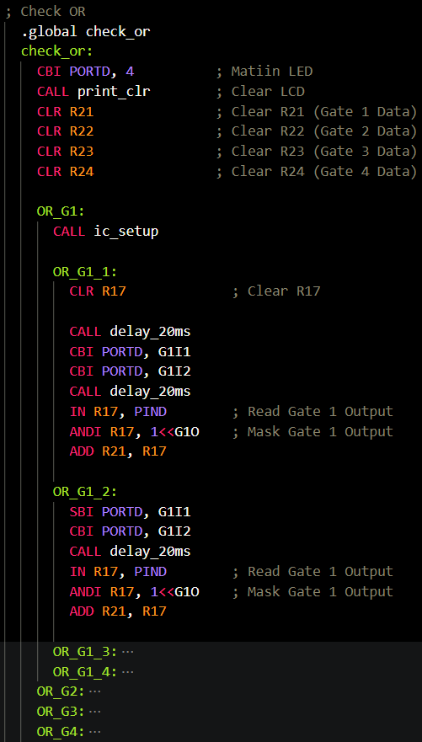
IC Check [Read]

Slide 36
IC Check [Compare]
OR_END:
MOV R16, R21 ; Store Gate 1 Output to R16
CALL print_R16_Hex ; Print Gate 1 Output
CALL print_newline ; Print New Line
MOV R16, R22 ; Store Gate 2 Output to R16
CALL print_R16_Hex ; Print Gate 2 Output
CALL print_newline ; Print New Line
MOV R16, R23 ; Store Gate 3 Output to R16
CALL print_R16_Hex ; Print Gate 3 Output
CALL print_newline ; Print New Line
MOV R16, R24 ; Store Gate 4 Output to R16
CALL print_R16_Hex ; Print Gate 4 Output
CALL print_newline ; Print New Line
ADD R21, R22 ; Add Gate 1 and Gate 2
ADD R21, R23 ; Add Gate 1, 2 and 3
ADD R21, R24 ; Add Gate 1, 2, 3 and 4
MOV R16, R21 ; Store Gate 1, 2, 3 and 4 to R16
CALL print_R16_Hex ; Print Gate 1, 2, 3 and 4
CALL print_newline ; Print New Line
CPI R21, 0xF8 ; Check if Gate 1, 2, 3 and 4 is 0xF8
BRNE OR_INCORRECT ; If not 0, jump to incorrect
SBI PORTD, 4
CALL print_or ; Print OR pada I2C
OR_INCORRECT:
RET ; !!!!!!!!!!!!!RETURN!!!!!!!!!!!!!!

Slide 37
IC Check [Compare]
OR_END:
MOV R16, R21 ; Store Gate 1 Output to R16
CALL print_R16_Hex ; Print Gate 1 Output
CALL print_newline ; Print New Line
MOV R16, R22 ; Store Gate 2 Output to R16
CALL print_R16_Hex ; Print Gate 2 Output
CALL print_newline ; Print New Line
MOV R16, R23 ; Store Gate 3 Output to R16
CALL print_R16_Hex ; Print Gate 3 Output
CALL print_newline ; Print New Line
MOV R16, R24 ; Store Gate 4 Output to R16
CALL print_R16_Hex ; Print Gate 4 Output
CALL print_newline ; Print New Line
ADD R21, R22 ; Add Gate 1 and Gate 2
ADD R21, R23 ; Add Gate 1, 2 and 3
ADD R21, R24 ; Add Gate 1, 2, 3 and 4
MOV R16, R21 ; Store Gate 1, 2, 3 and 4 to R16
CALL print_R16_Hex ; Print Gate 1, 2, 3 and 4
CALL print_newline ; Print New Line
CPI R21, 0xF8 ; Check if Gate 1, 2, 3 and 4 is 0xF8
BRNE OR_INCORRECT ; If not 0, jump to incorrect
SBI PORTD, 4
CALL print_or ; Print OR pada I2C
OR_INCORRECT:
RET ; !!!!!!!!!!!!!RETURN!!!!!!!!!!!!!!

Slide 38
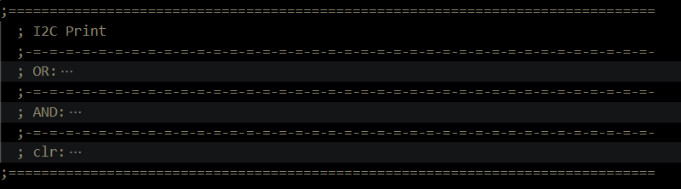
I2C Print Overview

Slide 39
I2C Print Overview
print_or:
CALL I2C_start ; transmit START condition
LDI R27, (0x27<<1) ; SLA+W (LCD_ADDRESS << 1) + W(0)
CALL I2C_write ; write slave address SLA+W
LDI R27, 0x00 ; Control byte: Co = 0, RS = 0 (instruction register)
CALL I2C_write ; write control byte
LDI R27, 0x80 ; Set DDRAM address to 0 (first line, first position)
CALL I2C_write ; write DDRAM address command
CALL I2C_start ; repeat START condition
LDI R27, (0x27<<1) ; SLA+W again
CALL I2C_write ; write slave address SLA+W
LDI R27, 0x40 ; Control byte: Co = 0, RS = 1 (data register)
CALL I2C_write ; write control byte
LDI R27, 'I'
CALL I2C_write
CALL LCD_delay
LDI R27, 'C'
CALL I2C_write
CALL LCD_delay
LDI R27, ' '
CALL I2C_write
CALL LCD_delay
LDI R27, 'O'
CALL I2C_write
CALL LCD_delay
LDI R27, 'R'
CALL I2C_write
CALL LCD_delay
CALL I2C_stop ; transmit STOP condition
RET ; !!!!!!!!!!!!!RETURN!!!!!!!!!!!!!!

Slide 40
Result

Slide 41
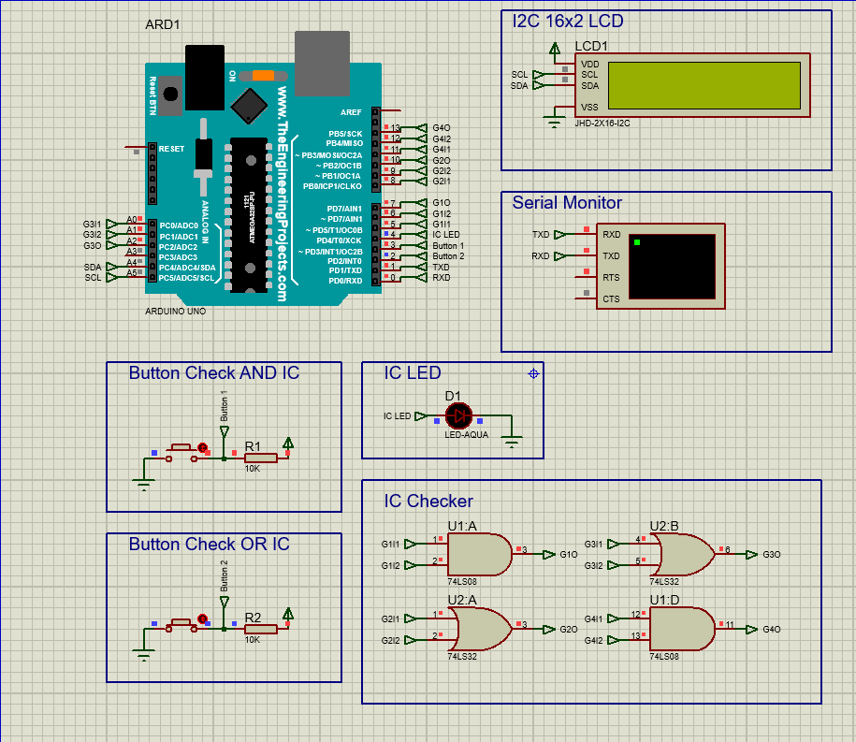
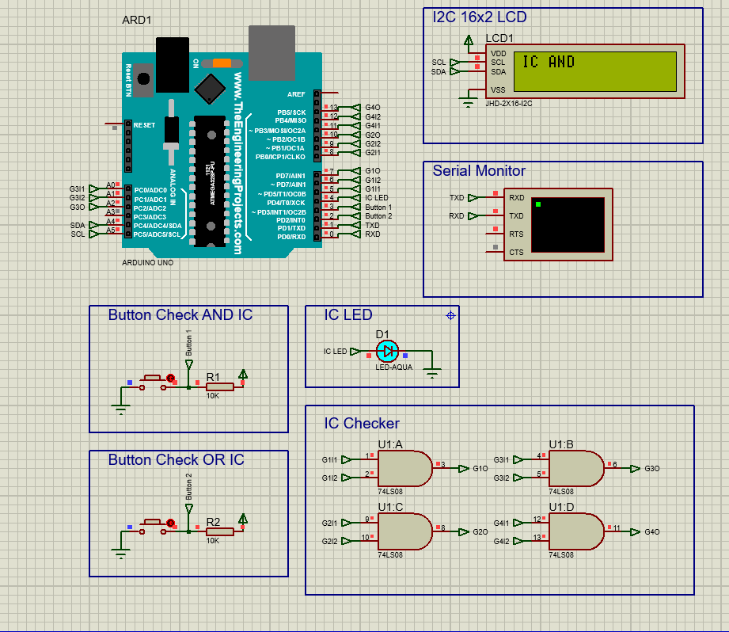
Result

Slide 42
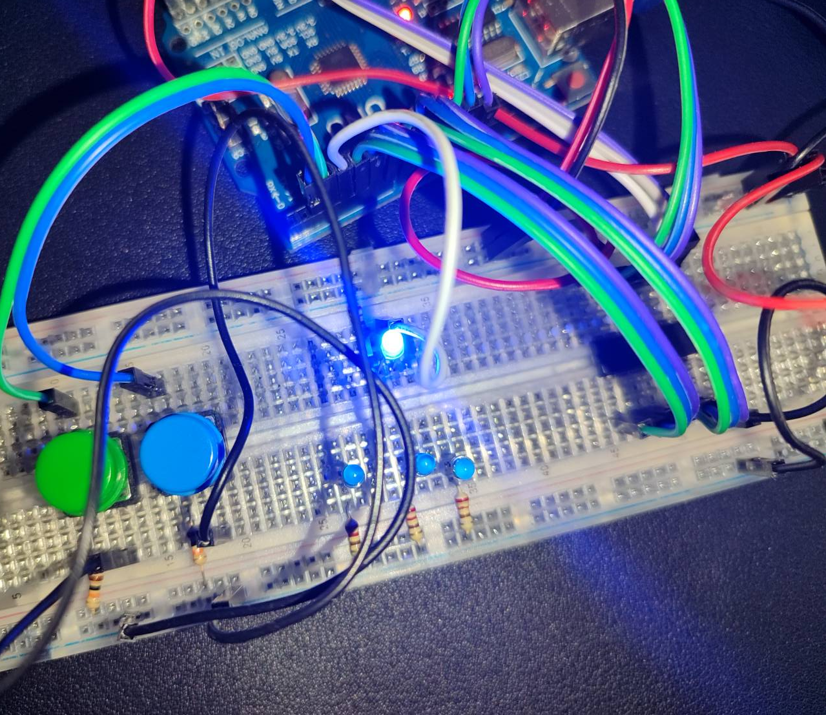
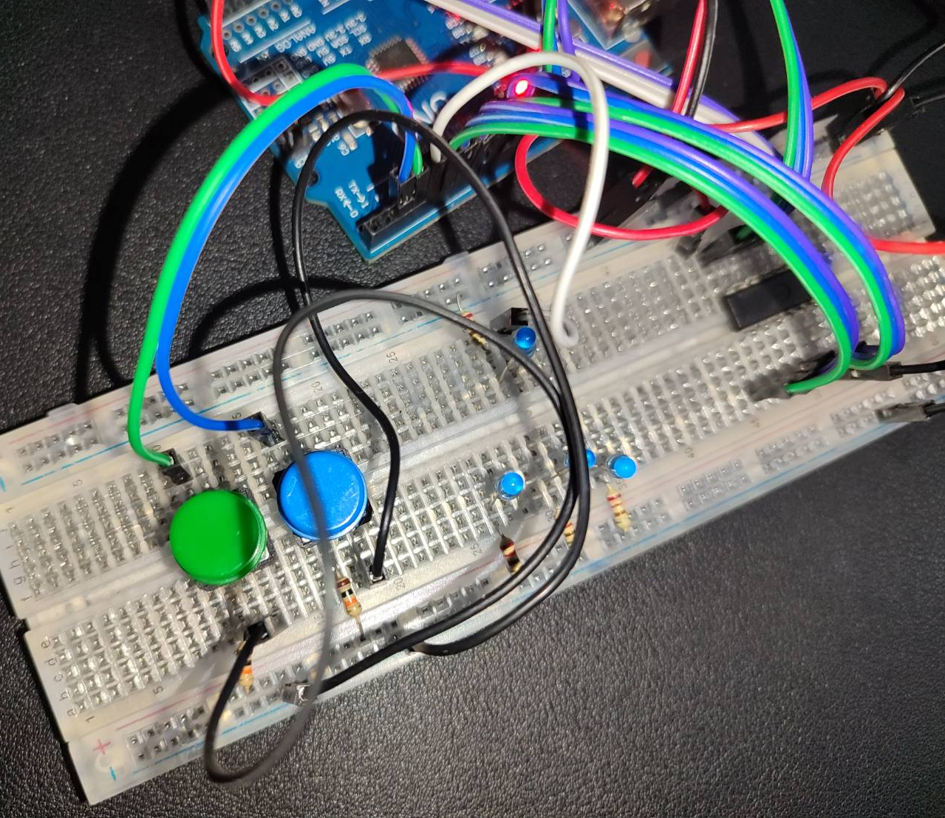
Result

Slide 43
Known Issues

Slide 44
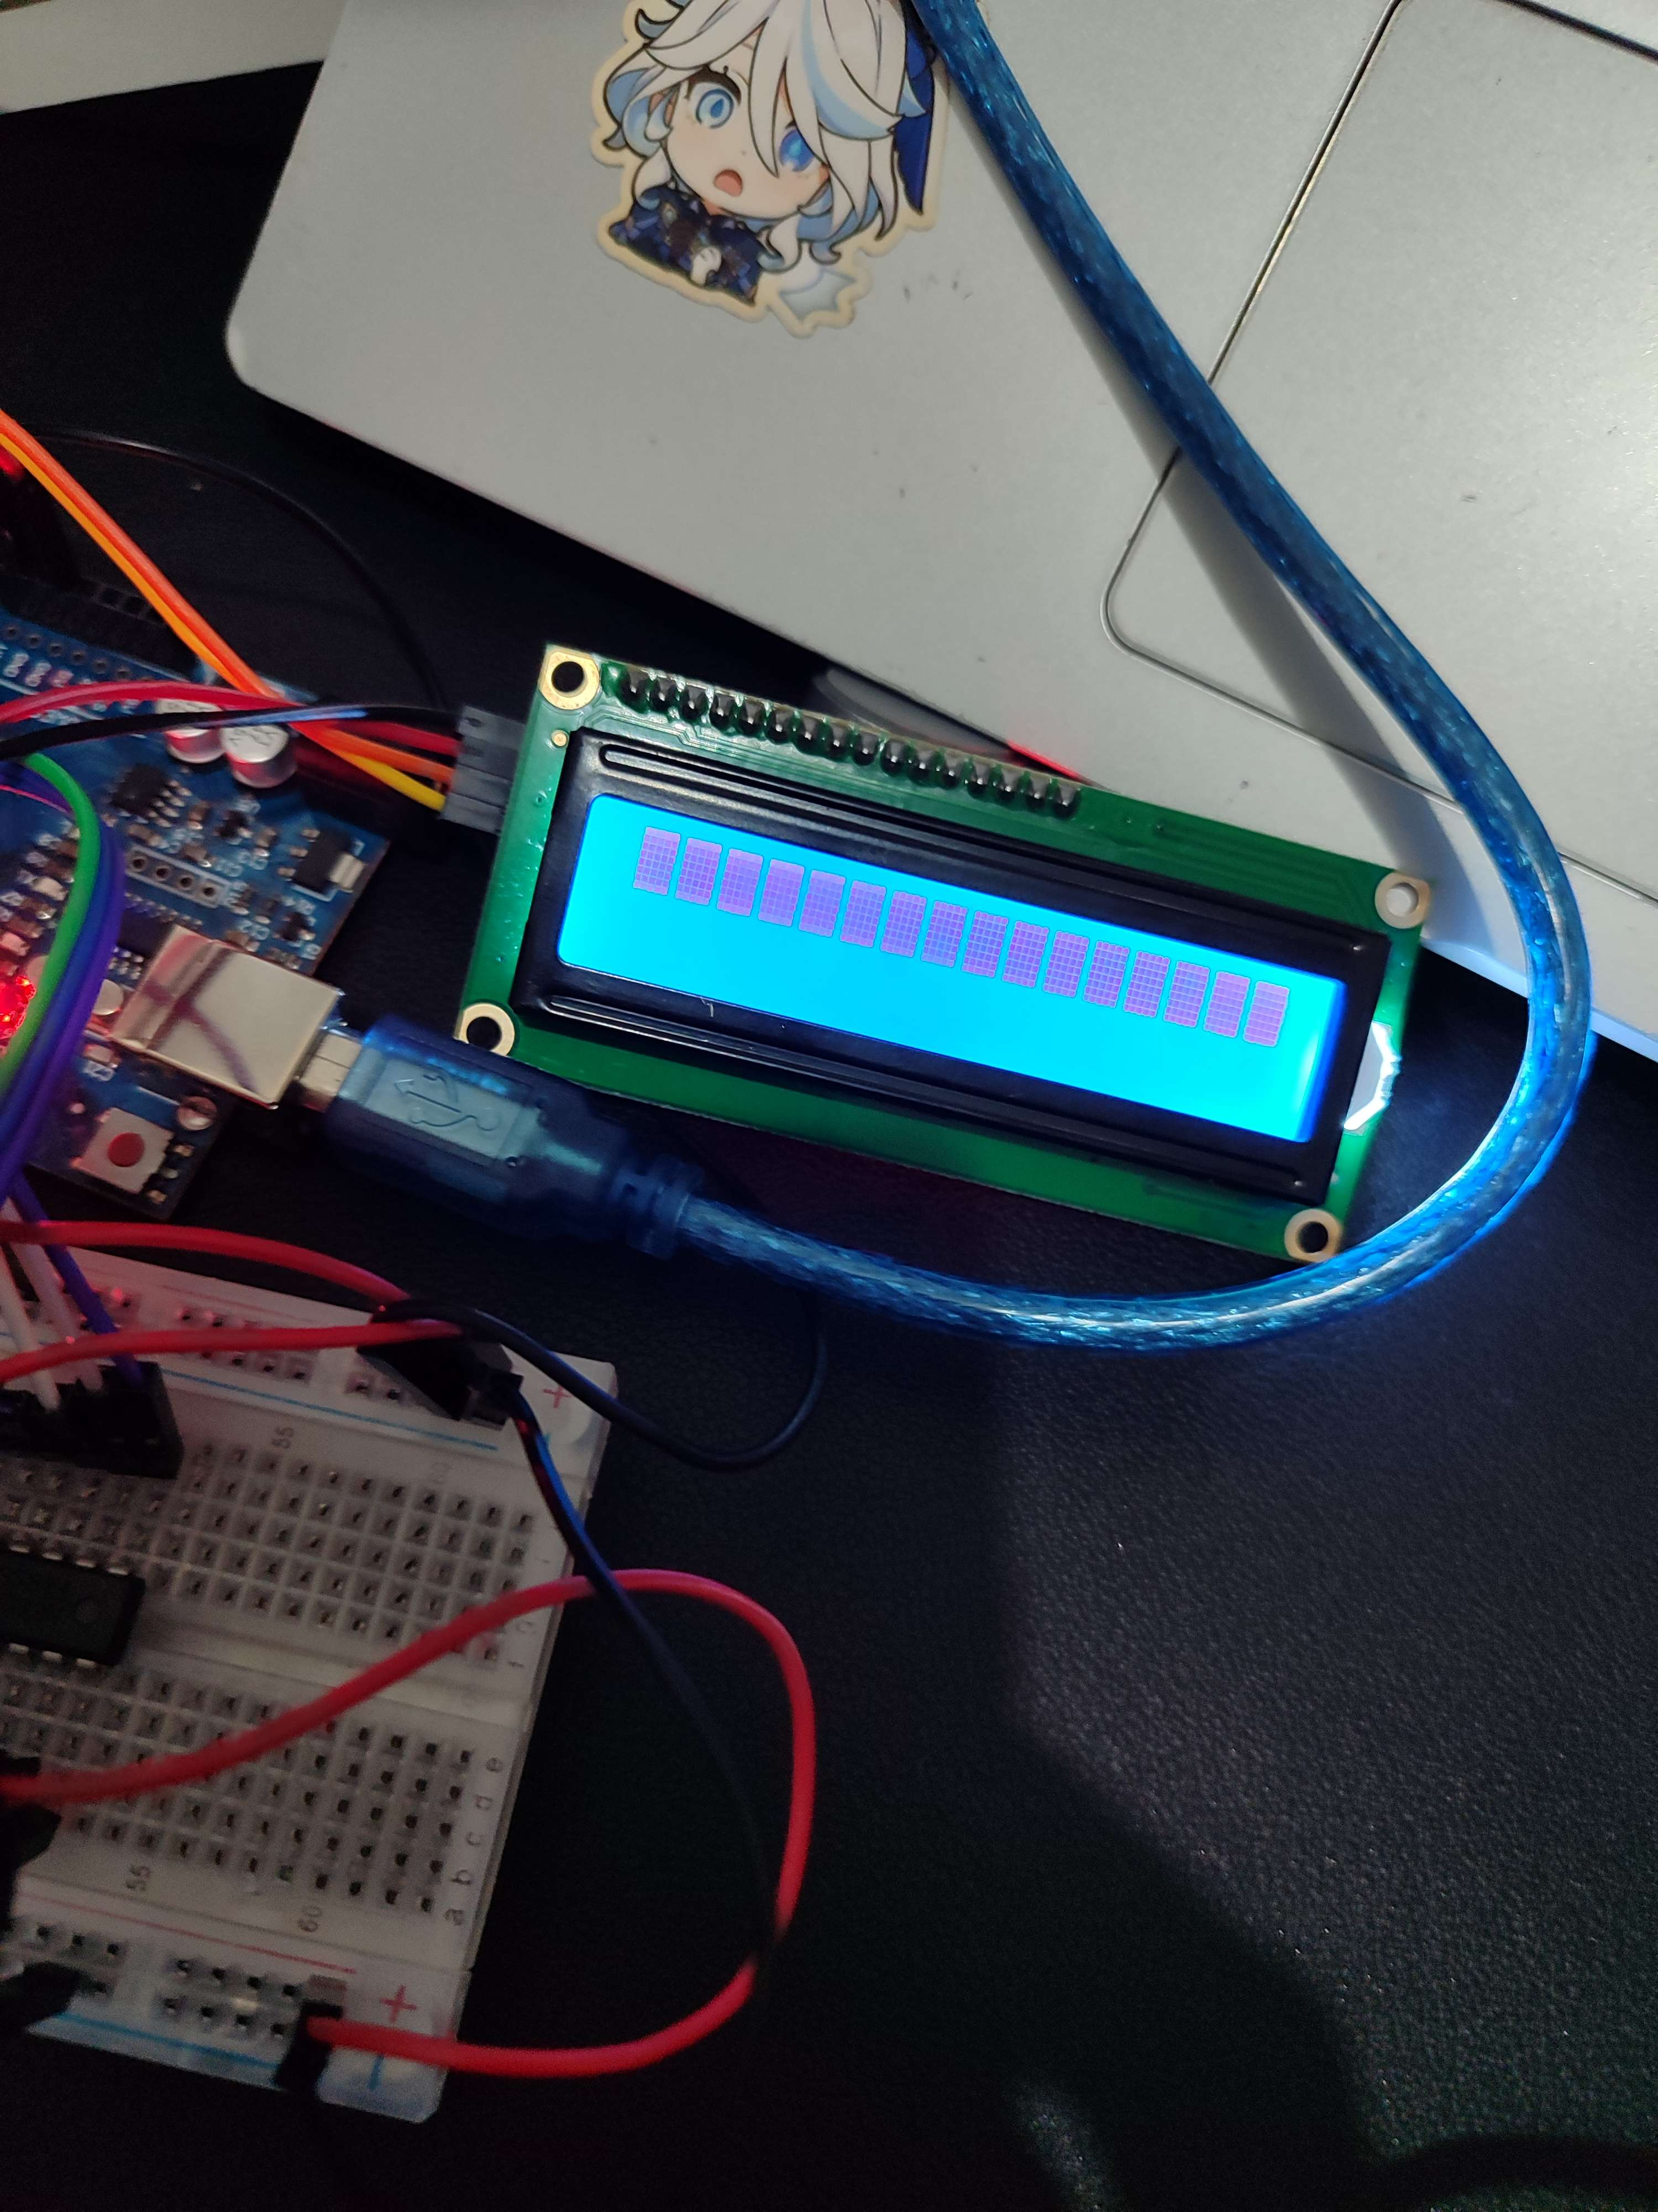
I2C LCD
LCD Kotak-Kotak
Teori kesalahan:
Delay I2C terlalu cepat/lambat, jadi mengakibatkan dioveride
Jika delay kurang, tertulis “I2C not ready”
Pada simulasi proteus bisa karena waktu di dunia proteus berbeda dengan dunia asli
Kemungkinan perbedaan komponen yang pada proteus dan dunia asli

Slide 45
Improvement Possibilities

Slide 46
Fix Issues
Memperbaiki penampilan LCD

Slide 47
More IC
Menambahkan lebih banyak IC yang bisa dites
Pada rangkaian sekarang terdapat 2 button untuk 2 IC, perkembangannya adalah 2 button, satu untuk cycle IC dan satu untuk confirm tes

Slide 48
Different IC
Rangkaian sekarang hanya bisa mengetes IC dengan struktur 2 input 1 output, perkembangannya adalah juga dapat memeriksa IC dengan struktur beda, bahkan yang memiliki lokasi vcc dan gnd yang tidak standar seperti IC 7476

Slide 49

Thank You

